Slide 1
M.KUMARASAMY COLLEGE OF ENGINEERING , KARUR.
Register Number : 927623BEC003,927623BEC018
Name : ABITHA BANU M, BHARATHI S
Date : 06.06.2025

Slide 2
TITLE OF THE PROJECT
HEMOCARE SYSTEM

Slide 3
Abstract
The Blood Bank Management System is a simplified software application developed to manage and organize the records of blood donations and requests effectively.
It allows an authorized user to log in and perform essential operations like donating blood, requesting blood, checking current blood inventory, and viewing donor and requester details.
The system stores data locally using browser-based storage mechanisms, eliminating the need for a back end server or complex database.
By automating key functions such as inventory updates and record-keeping, the system ensures faster and more accurate handling of blood stock information.
It not only saves time but also reduces manual errors and maintains real-time availability of different blood groups.

Slide 4
Literature Review
Year | Authors | Title of the Paper | Algorithm/ Methodologies/ Techniques | Findings
2022 | Nur Maryam Sufiah Azhar, Firkhan Ali Hamid Ali | Web-based Development: Smart Blood Bank Management System | Waterfall model; developed using Visual Studio Code and phpMyAdmin | This system includes modules for login , donor management, blood donation , recipient management and user management.
2021 | Aan erlansari, Rusdi Effendi, FunnyFarady C, Andang Wijanarko, Boko Susilo, Reza Hardiansyah | Development of a Blood Bank Management System | Backpropagation neural networks; Fuzzy Tahani method | Developed a model to identify potential blood donors during the COVID-19 pandemic by considering factors like age, weight, and donation history, aiming to address blood shortages and ensure timely donations.

Slide 5
Problem(s) Identified
Design and develop a Blood Bank Management System that automates the process of registering blood donors, managing blood inventory, processing blood requests, and ensuring blood safety. The system should efficiently track donor details, blood stock levels, and recipient requests, ensuring real-time availability and minimizing errors. It should also provide features for blood group matching, request approvals, and expiry date tracking to ensure safe and efficient blood distribution.

Slide 6
Proposed Solution
The proposed solution is to develop a standalone Blood Bank Management System using a programming language like HTML with data stored locally using browser storage.
This system allows an authorized admin to log in and manage blood donations and requests.
Donors can input their details and donate blood, while requestors can request specific blood groups and quantities.
The system updates the blood inventory automatically based on donations and requests and displays the current stock of all blood groups. It also keeps a record of all donors and requestors for future reference.
This solution helps in organizing and managing blood data more efficiently without the need for internet connectivity or a database server.

Slide 7
Objectives
Maintain real-time records of blood donors and requestors.
Track and update the blood inventory dynamically.
Provide a user-friendly interface for donating and requesting blood.
Ensure quick access to donor and requestor details for emergency use.
Minimize manual work and reduce human error in managing blood bank data.

Slide 8
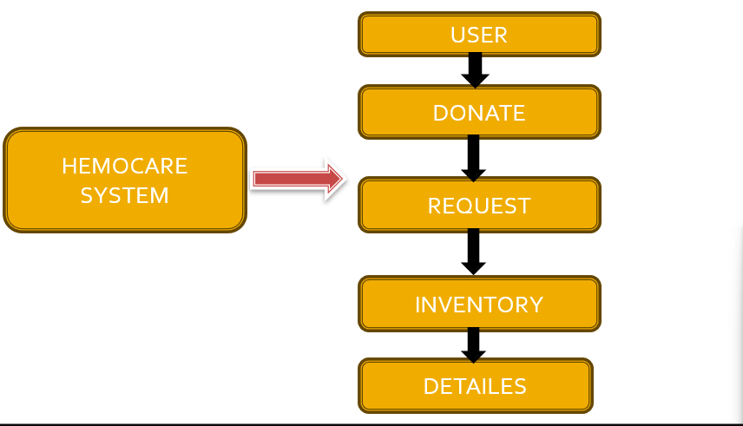
Architecture Diagram

Slide 9
Architecture Diagram Explanation
1. USER:
The system starts by interacting with the user. A user logs into the system using a predefined username and password. Only authorized users can proceed to use the features of the Hemocare System.
2. DONATE:
After login, users can choose to donate blood. In this module, the donor’s name, blood group, and quantity are entered. This data is used to update the blood stock in the inventory.
3. REQUEST:
Users can also request blood. The requestor’s name, blood group needed, and quantity are provided. The system checks the inventory to see if the requested blood is available and updates it accordingly.
4. INVENTORY:
This module keeps a live count of blood units available for each blood group. It is updated automatically based on the donation and request operations.
5. DETAILS:
Finally, the system maintains a record of all donor and requestor information. This includes name, type (Donor or Requestor), blood group, and units involved.

Slide 10
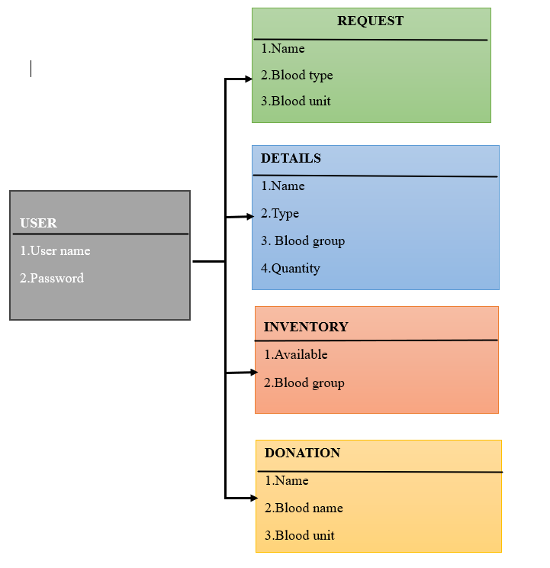
Schema Diagram

Slide 11
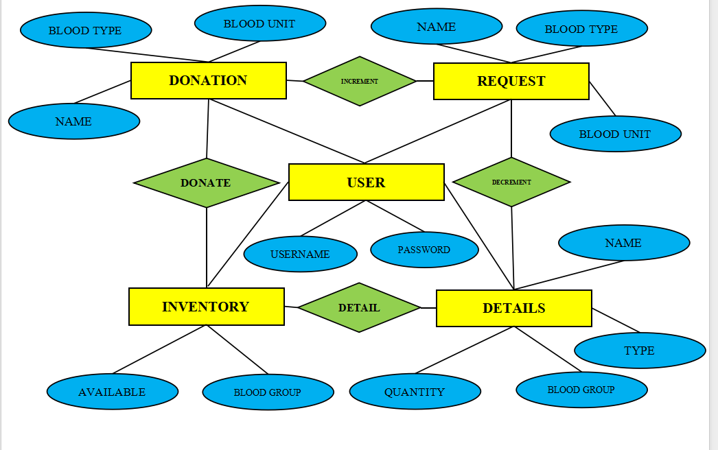
ER diagram

Slide 12
Software Description
1. The system provides secure login access for donors, requestors, and administrators.
2. Donors can submit their details and donate blood, which automatically updates the inventory.
3. Users can request blood by selecting the required blood group and checking availability.
4. Administrators can manage all data, track donations and requests, and monitor real-time blood stock.

Slide 13
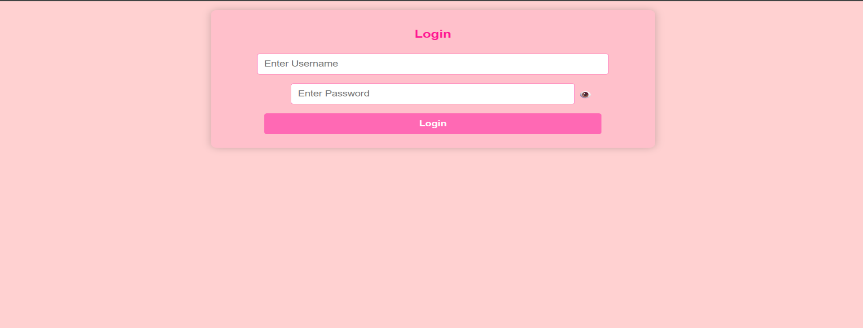
Results & Discussion
This figure displays the Login Page of the Hemocare System.
It features two input fields for the user to enter their Username and Password, along with a toggle eye icon next to the password field to show or hide the entered characters for better usability.

Slide 14

Results & Discussion Cont..
The figure shows the main dashboard of the Hemocare System, a Blood Bank Management application.
It features a welcoming message at the top and five centrally aligned buttons: "Donate Blood," "Request Blood," "View Inventory," "Donor & Requestor Details," and "Logout."
Each button provides quick access to essential functionalities, allowing users to navigate through the system efficiently.

Slide 15
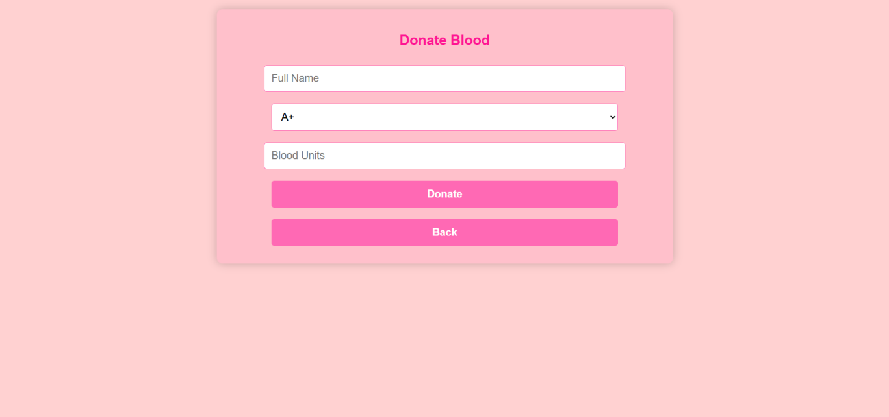
Results & Discussion Cont..
This figure shows the Donate Blood Page of the Hemocare System, designed to collect blood donation details from users.
The form includes input fields for the Full Name, a dropdown menu to select the Blood Group, and a field to enter the number of Blood Units being donated.
Below the form are two labeled buttons: Donate, which submits the donation details, and Back, which returns the user to the previous page.

Slide 16
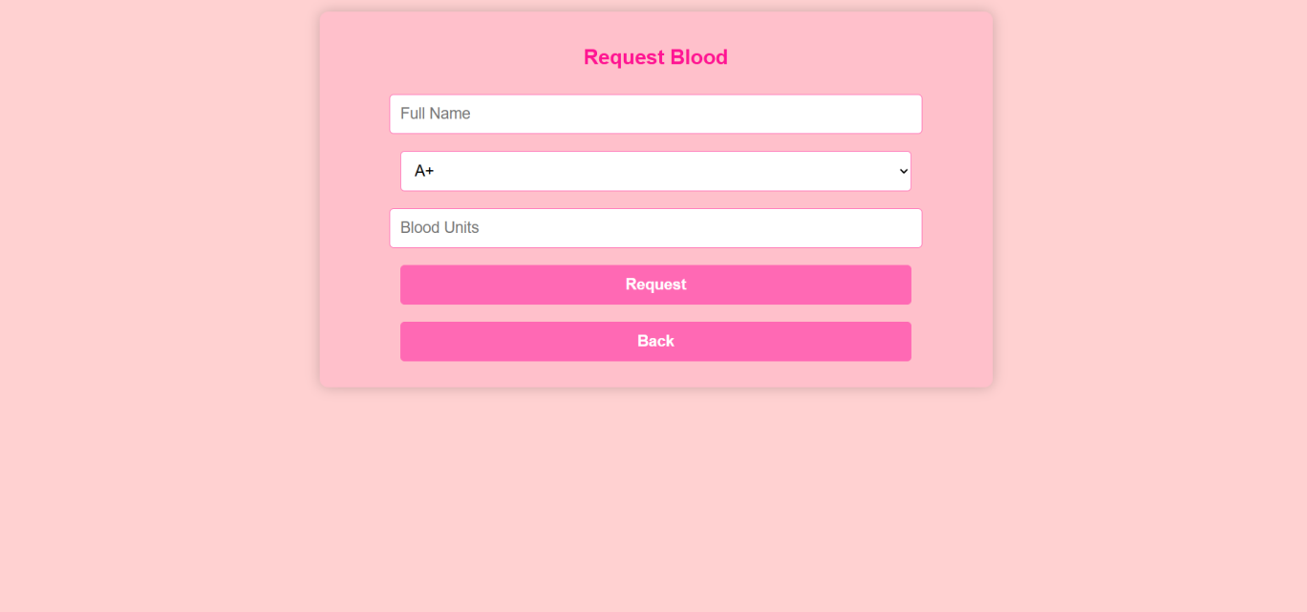
Results & Discussion Cont..
The "Request Blood" form is a user-friendly interface in a Blood Bank Management System that allows users to request specific blood units.
It features a clean design with input fields for the full name, blood group (selected from a dropdown), and the number of blood units needed.
Two clearly labeled buttons—"Request" to submit the form and "Back" to return to the previous page—are provided for smooth navigation.

Slide 17
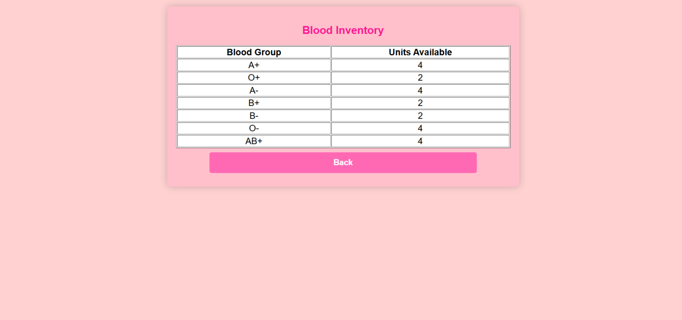
Results & Discussion Cont..
This figure shows the Blood Inventory Page of the Hemocare System, which displays the current availability of different blood groups.
The table is organized into two columns: Blood Group and Units Available, allowing users to easily check stock levels for A+, O+, A-, B+, B-, O-, and AB+ blood types. The data is presented in a clean, tabular format, making it user-friendly and accessible.
A prominent Back button at the bottom allows users to return to the previous screen.

Slide 18
Conclusion
Improved Efficiency: The system streamlines blood donation and request processes with real-time inventory tracking and smooth workflow.
Secure and Accurate: Role-based access and secure data storage ensure sensitive information is protected and operations are error-free.
User-Friendly Design: A simple interface benefits donors, requestors, and admins, making blood management more effective and accessible.

Slide 19
Reference
[1]. Balagurusamy, E. Programming in ANSI C. McGraw Hill Education.
[2]. Elmasri, Ramez, and Navathe, Shamkant B. Fundamentals of Database Systems. Pearson Education, Seventh Edition.
[3]. Korth, Henry F., Silberschatz, Abraham, and Sudarshan, S. Database System Concepts. McGraw Hill, Seventh Edition, 2021.
[4]. PHP Manual (2025). "PHP: Hypertext Preprocessor." PHP Documentation.
[5]. Pressman, Roger S. Software Engineering: A Practitioner’s Approach. McGraw Hill.

